Slide 1
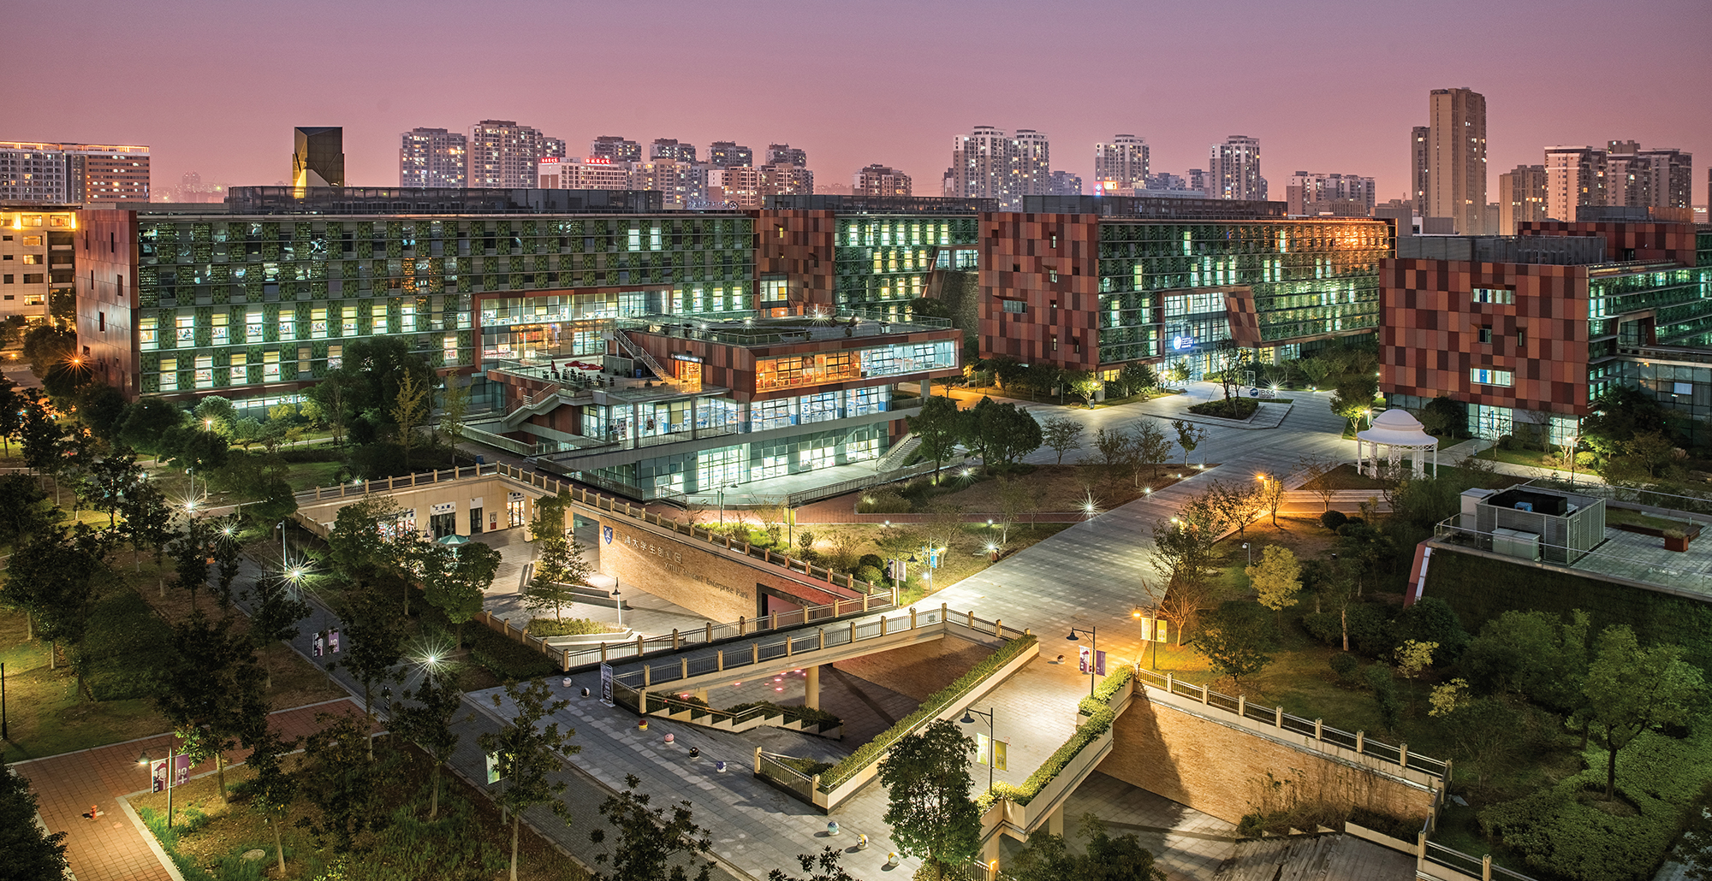

A brief illustration of PCA
INT301 Bio-computation, Week 10, 2025
Notes:
Images should be RGB colour setting
Header: Uppercase, Calibri size 28, XJTLU Navy
Body Text: Sentence case, Calibri size 14, Black

Slide 2
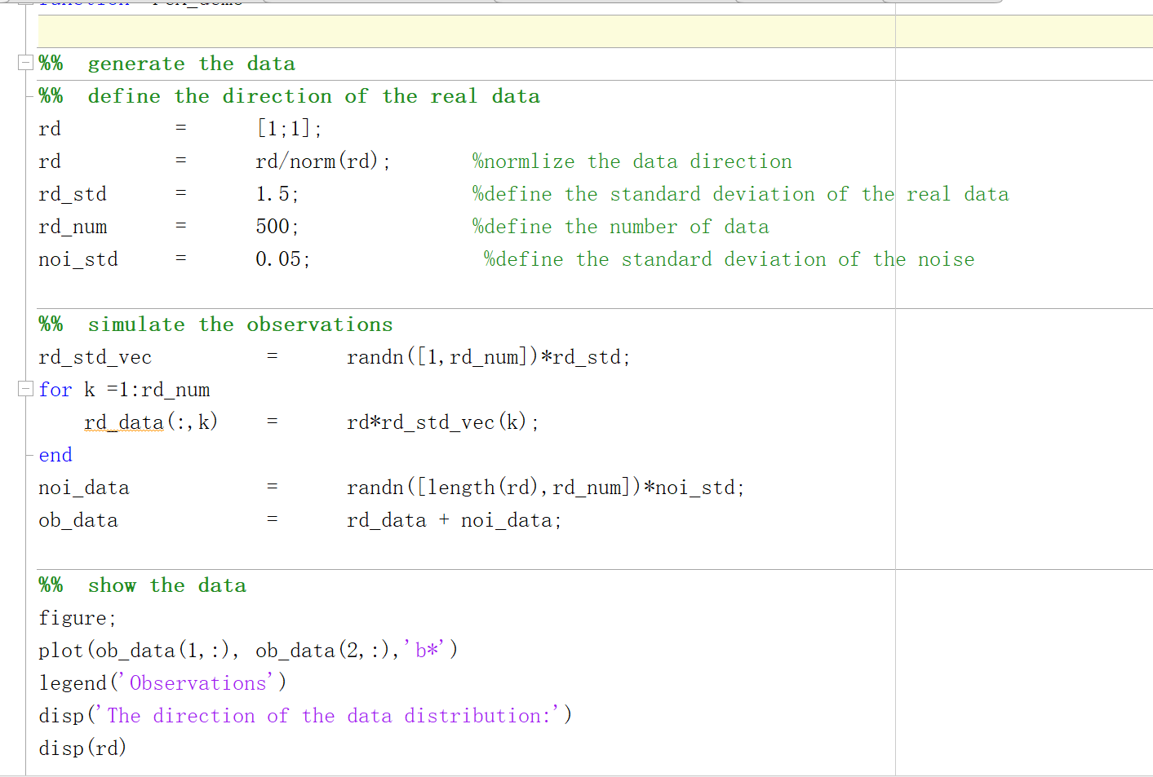
Data Simulation

Slide 3
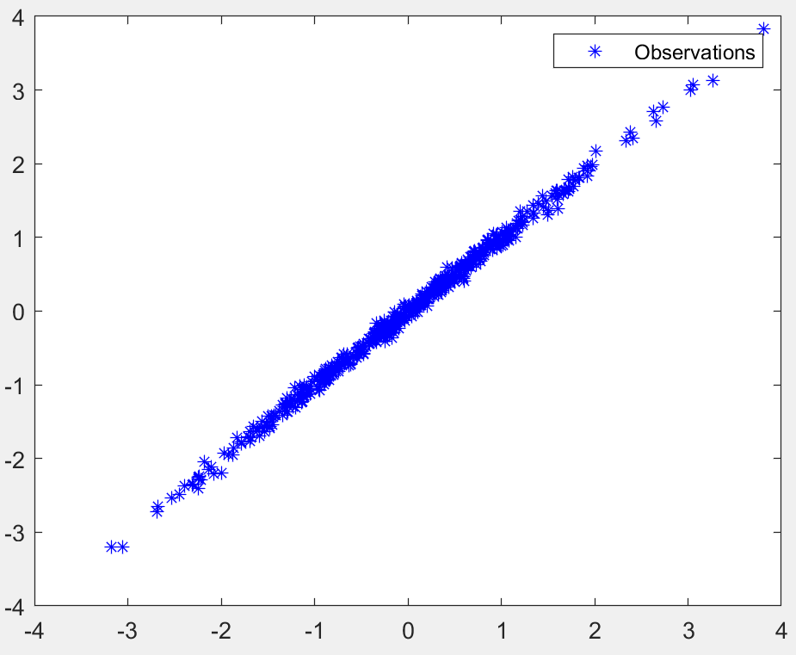
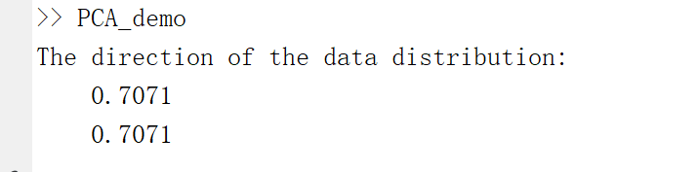
Data Simulation

Slide 4
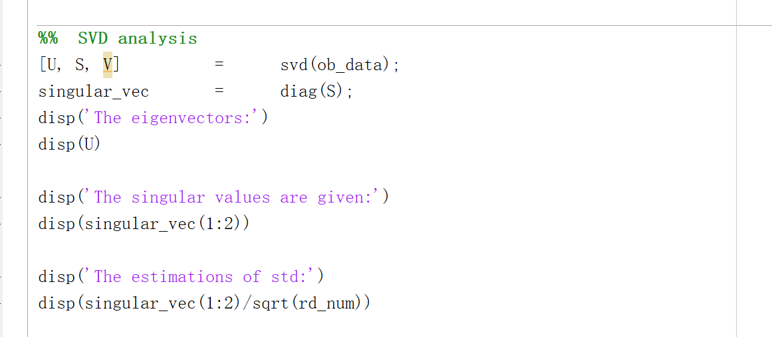
SVD

Slide 5
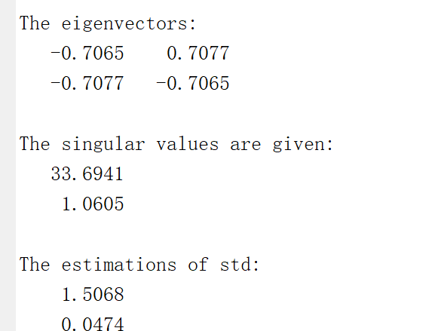
SVD

Slide 6
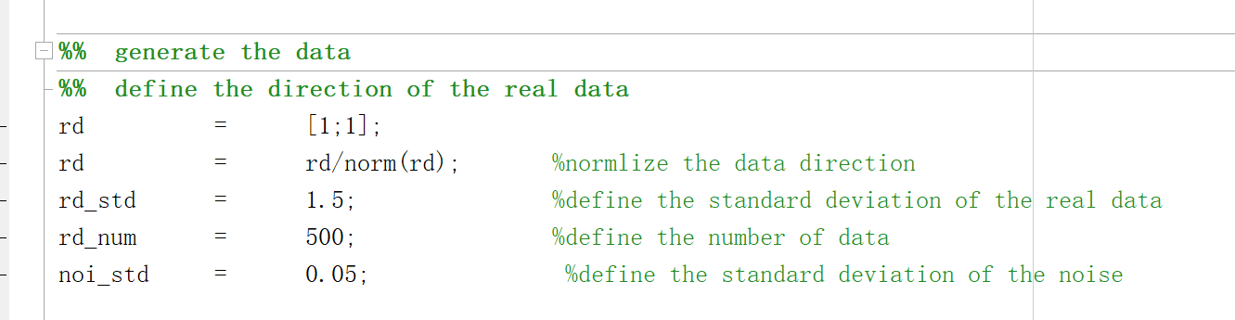
SVD

Slide 7
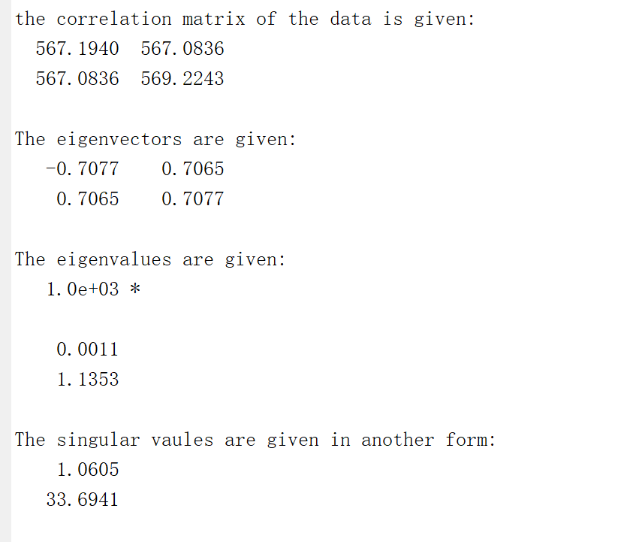
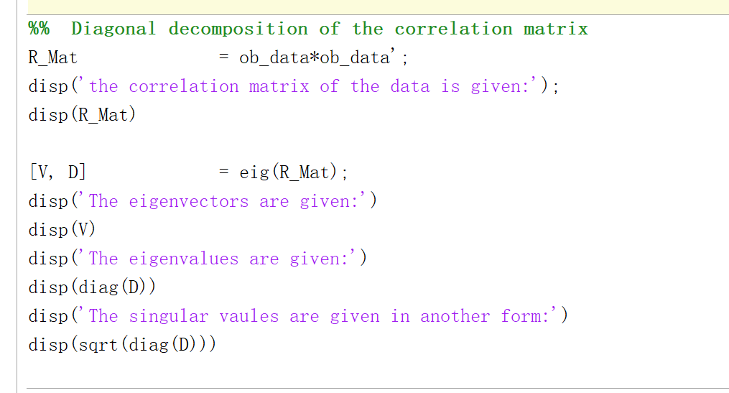
Diagonal decomposition of the correlation matrix

Slide 8
Diagonal decomposition of the correlation matrix

Slide 9
Diagonal decomposition of the correlation matrix

Slide 10
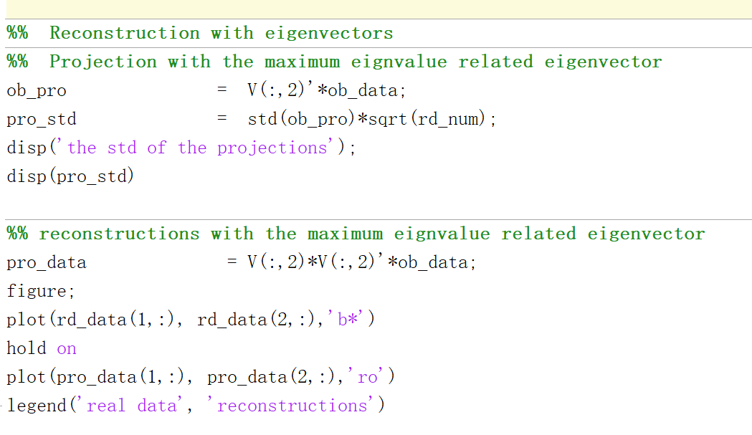
Projection and reconstruction

Slide 11
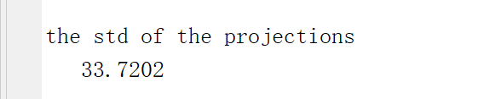
Projection and reconstruction

Slide 12
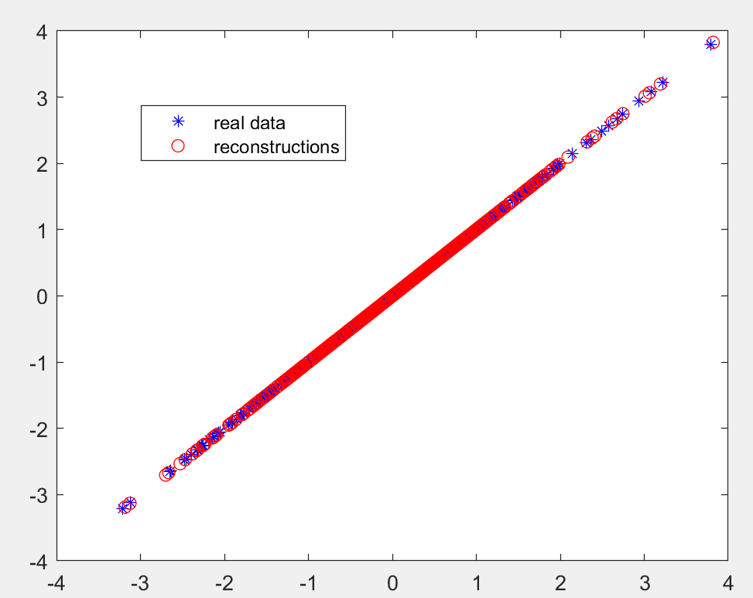
Projection and reconstruction

Slide 13
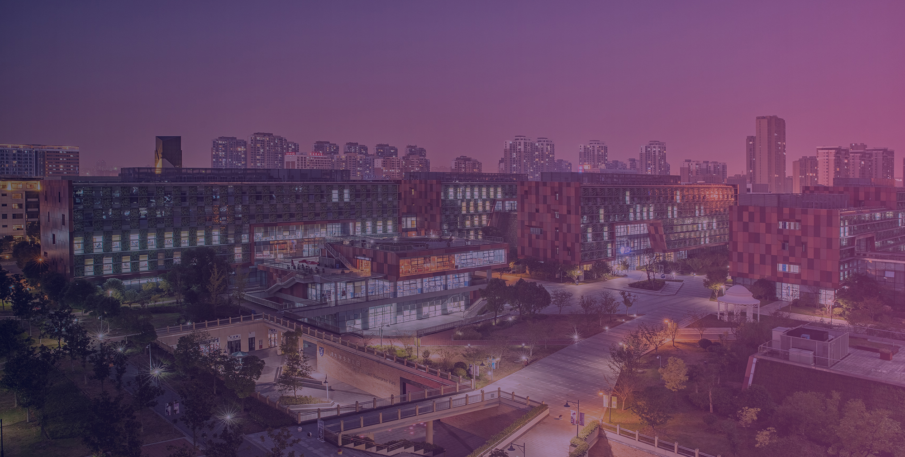


THANK YOU
Visit us
FOLLOW us
www.xjtlu.edu.cn
@xjtlu
Notes:
Title: Uppercase, Calibri size 60, XJTLU Navy

